Slide 1
SLAM : Simultaneous Localization and Mapping
many slides from Autonomous Systems Lab (ETH Zürich)

Slide 2
The SLAM Problem
SLAM is the process by which a robot builds a map of the environment and, at the same time, uses this map to compute its location
Localization: inferring location given a map
Mapping: inferring a map given a location
SLAM: learning a map and locating the robot simultaneously

Slide 3
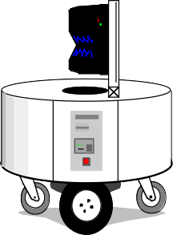
The SLAM Problem
SLAM is a chicken-or-egg problem:
→ A map is needed for localizing a robot
→ A pose estimate is needed to build a map
Thus, SLAM is (regarded as) a hard problem in robotics

Slide 4
The SLAM Problem
SLAM is considered one of the most fundamental problems for robots to become truly autonomous
A variety of different approaches to address the SLAM problem have been presented
Probabilistic methods rule
History of SLAM dates back to the mid-eighties
(stone-age of mobile robotics)

Slide 5
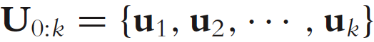
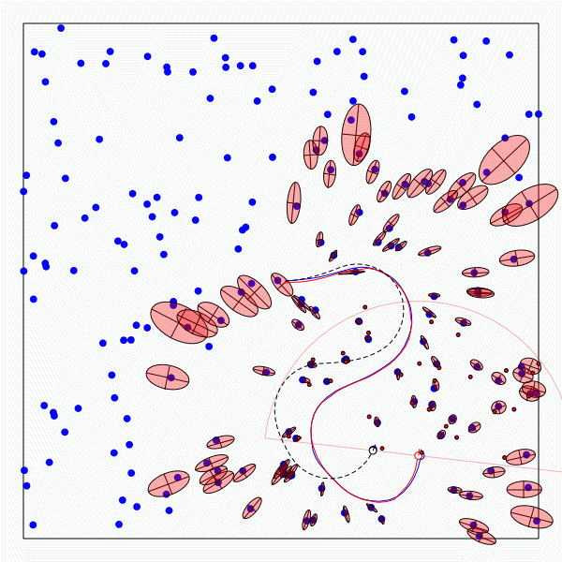
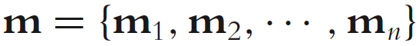
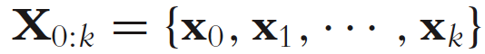
The SLAM Problem
Given:
The robot’s controls
Relative observations
Wanted:
Map of features
Path of the robot

Slide 6
Structure of the Landmark- based SLAM-Problem

Slide 7
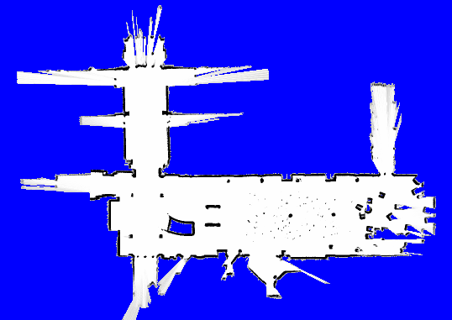
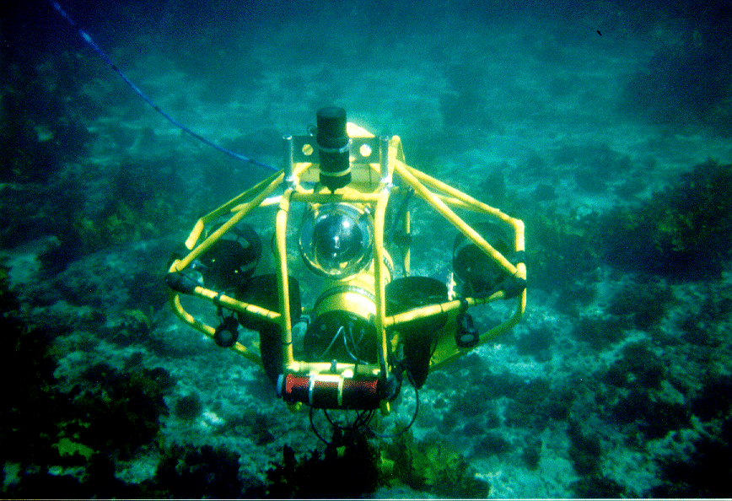
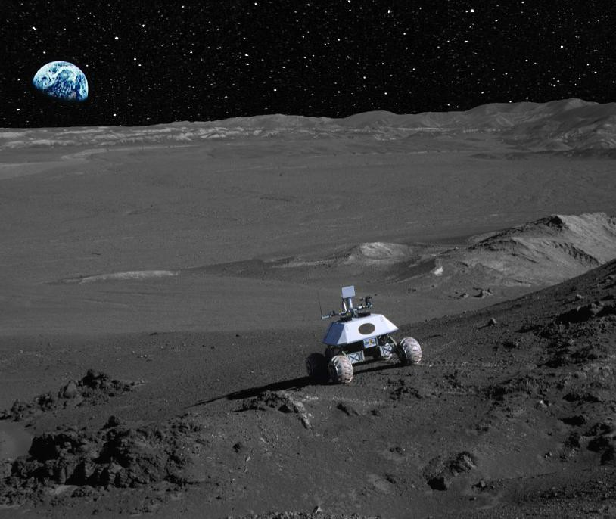
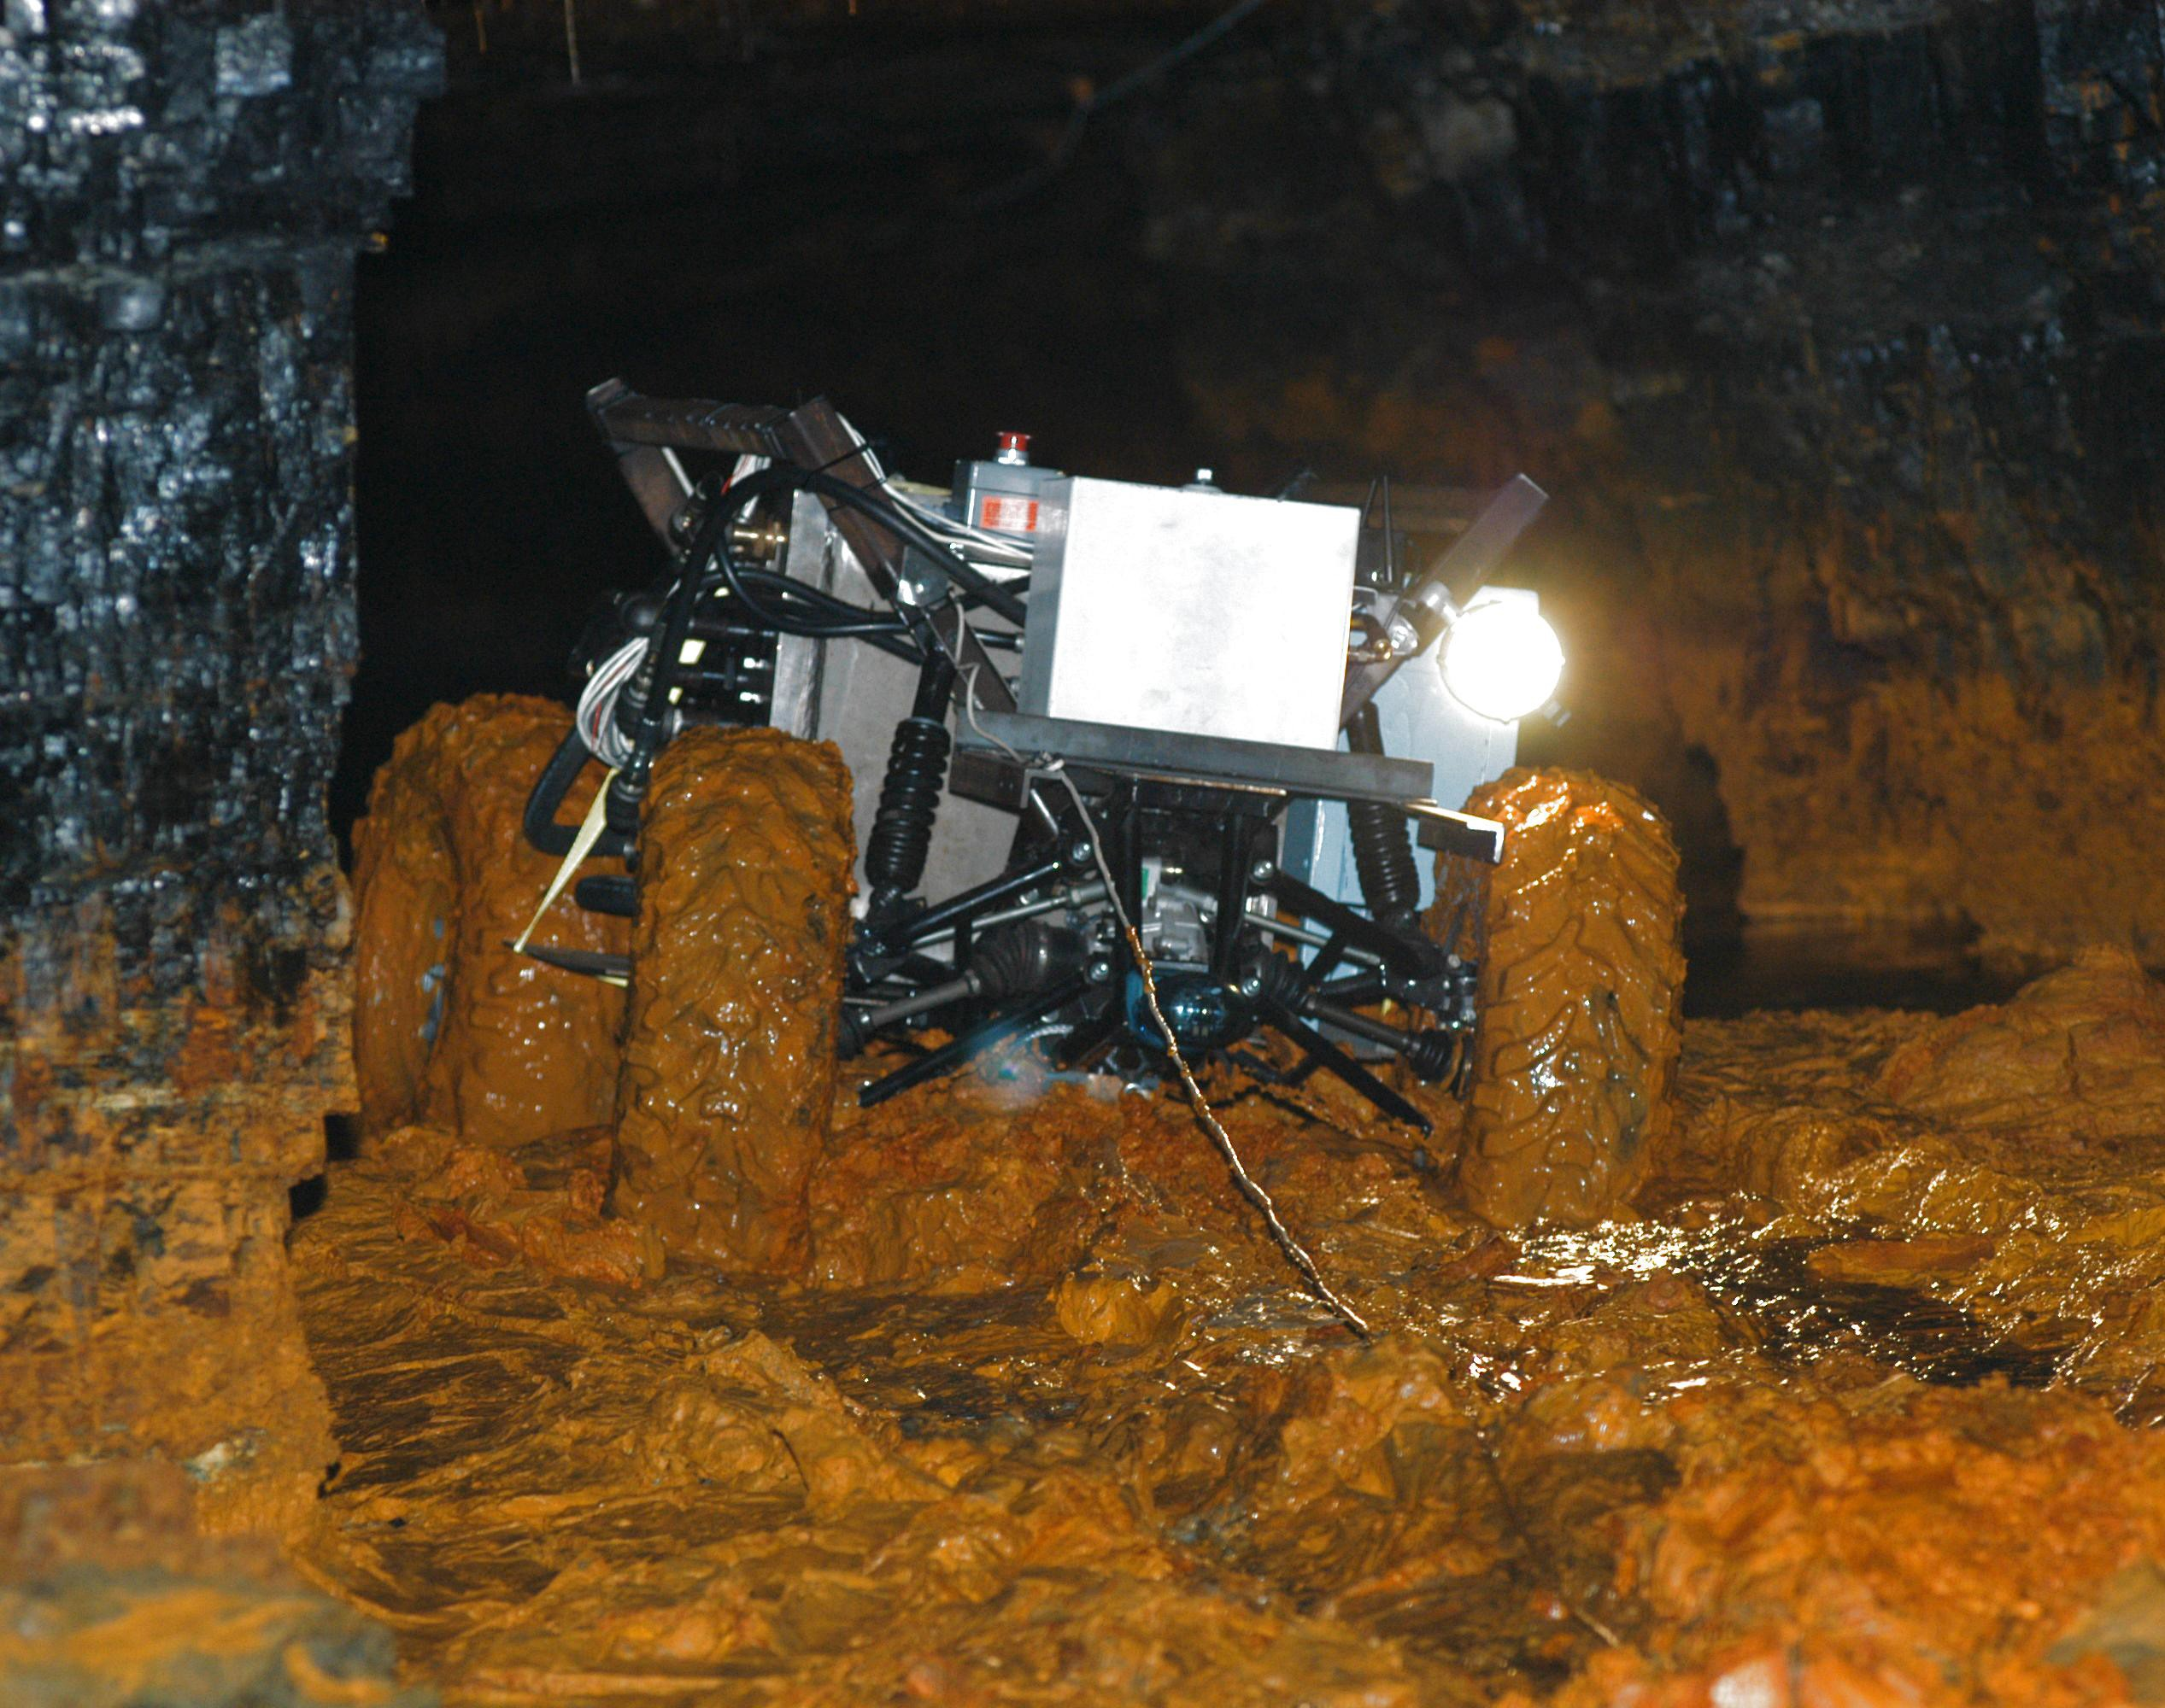
SLAM Applications
Indoors
Undersea
Space
Underground

Slide 8
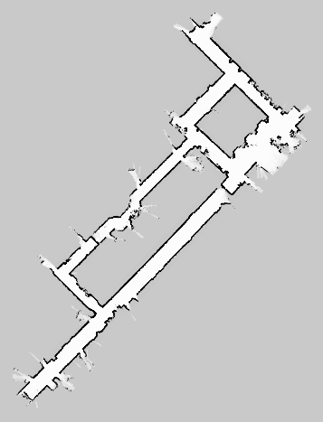
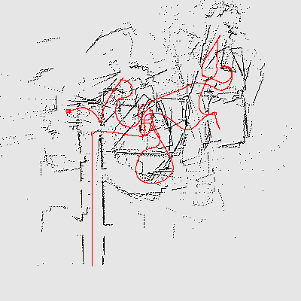
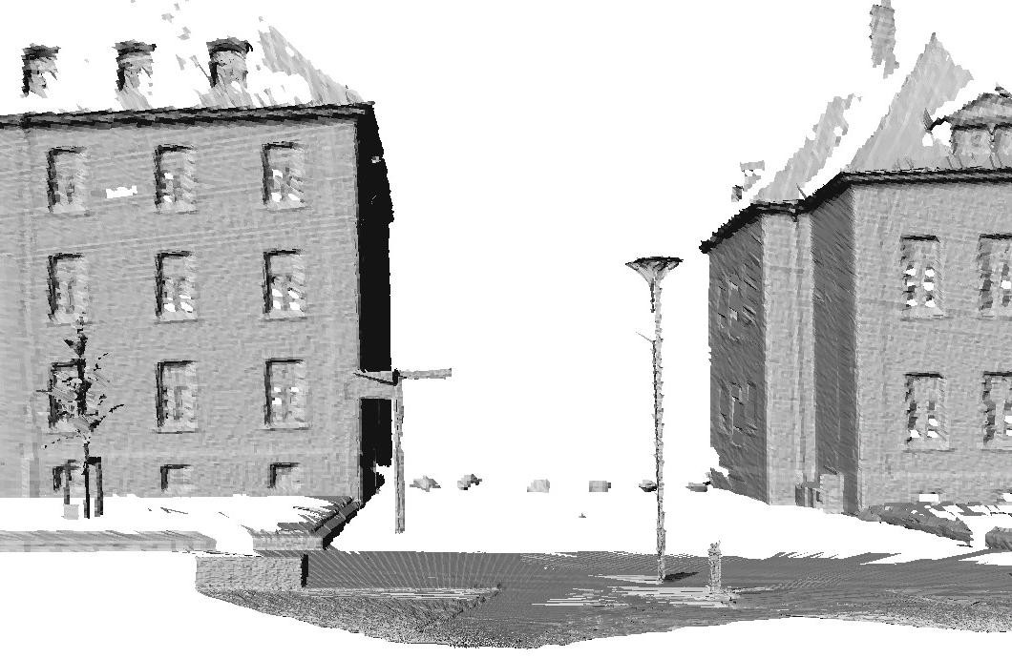
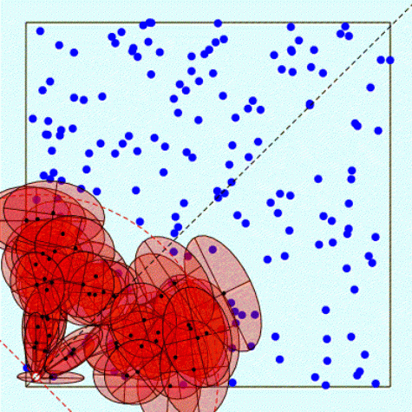
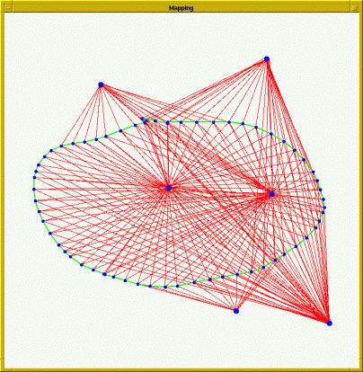
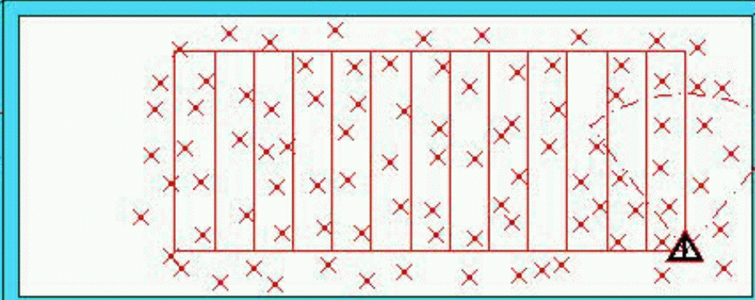
Representations
Grid maps or scans
[Lu & Milios, 97; Gutmann, 98: Thrun 98; Burgard, 99; Konolige & Gutmann, 00; Thrun, 00; Arras,
99; Haehnel, 01;…]
Landmark-based
[Leonard et al., 98; Castelanos et al., 99: Dissanayake et al., 2001; Montemerlo et al., 2002;…

Slide 9
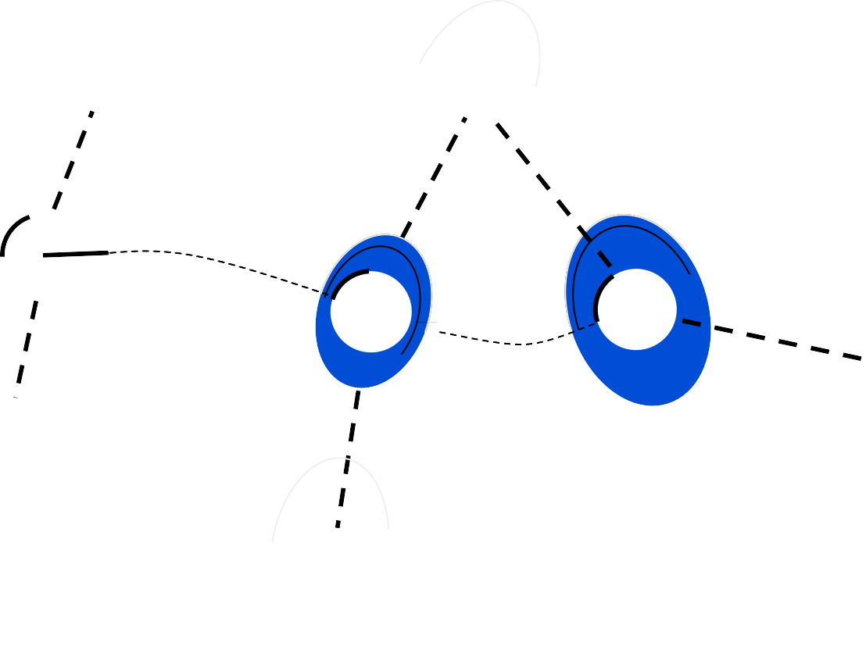






Why is SLAM a hard problem?
SLAM: robot path and map are both unknown
Robot path error correlates errors in the map

Slide 10





Why is SLAM a hard problem?
Robot pose uncertainty
In the real world, the mapping between observations and landmarks is unknown
Picking wrong data associations can have catastrophic consequences
Pose error correlates data associations

Slide 11
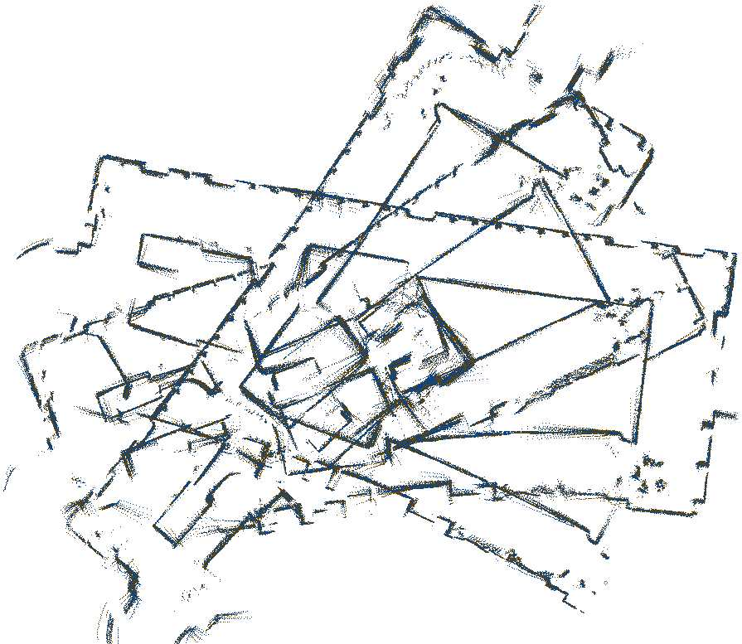
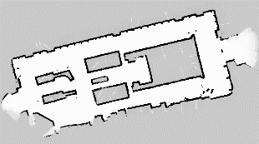
Cyclic Environments
Small local error accumulate to arbitrary large global errors!
This is usually irrelevant for navigation
However, when closing loops, global error does matter

Slide 12
SLAM:
Simultaneous Localization and Mapping
Full SLAM:
p(x_{1:t} , m | z_{1:t} ,u_{1:t} )
Estimates entire path and map!
Online SLAM:
p(x_{t} , m | z_{1:t} ,u_{1:t} ) = ∫ ∫…∫ p(x_{1:t} , m | z_{1:t} ,u_{1:t} ) dx₁dx₂...dx_{t −1}
Integrations (marginalization) typically done one at a time
Estimates most recent pose and map!

Slide 13
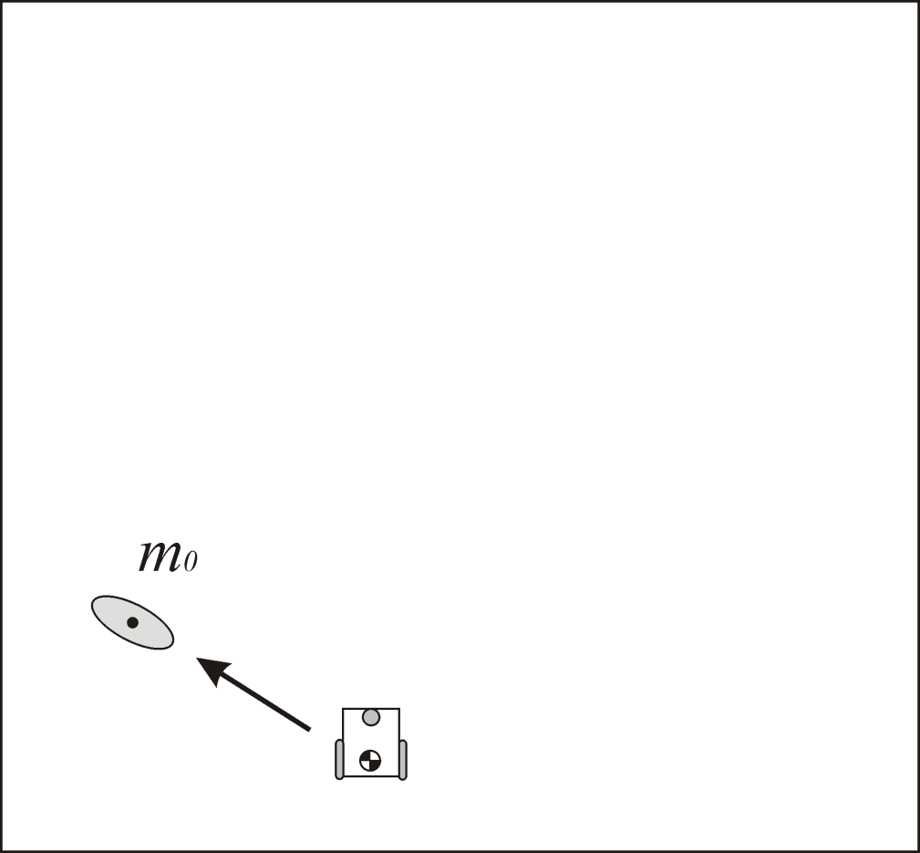
SLAM overview
Let us assume that the robot uncertainty at its initial location is zero.
From this position, the robot observes a feature which is mapped with an uncertainty related to the exteroceptive sensor error model

Slide 14
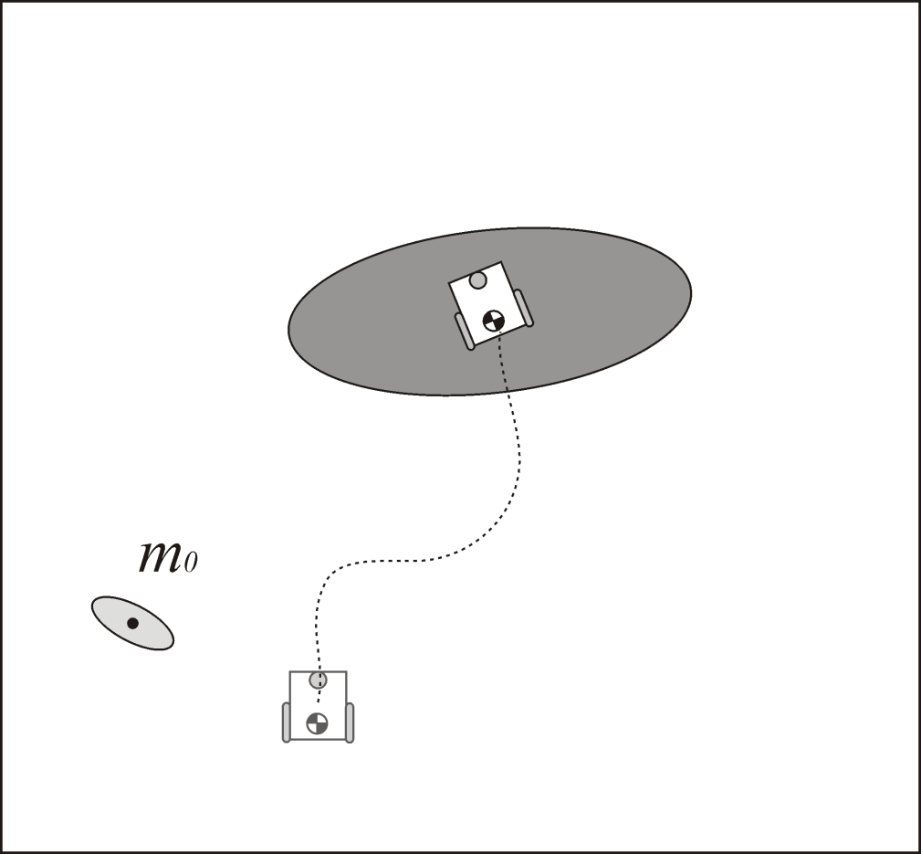
SLAM overview
As the robot moves, its pose uncertainty increases under the effect of the errors introduced by the odometry

Slide 15
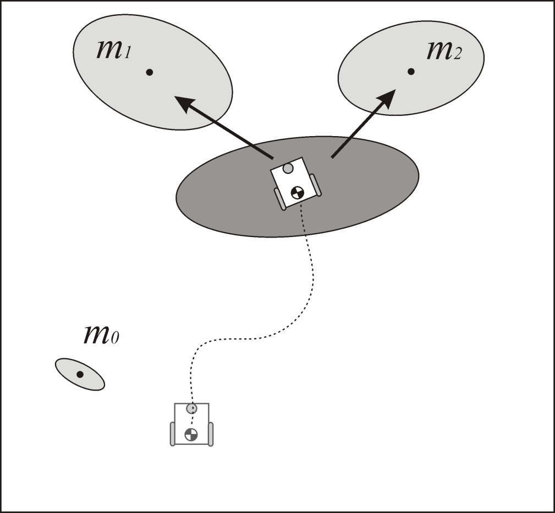
SLAM overview
At this point, the robot observes two features and maps them with an uncertainty which results from the combination of the measurement error with the robot pose uncertainty
From this, we can notice that the map becomes correlated with the robot position estimate. Similarly, if the robot updates its position based on an observation of an imprecisely known feature in the map, the resulting position estimate becomes correlated with the feature location estimate.

Slide 16
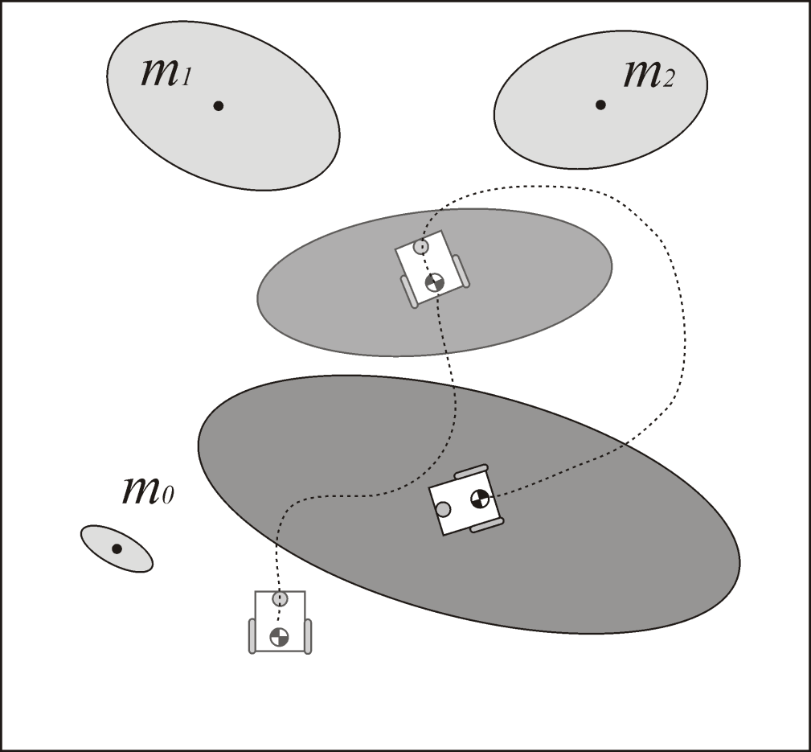
SLAM overview
The robot moves again and its uncertainty increases under the effect of the errors introduced by the odometry

Slide 17
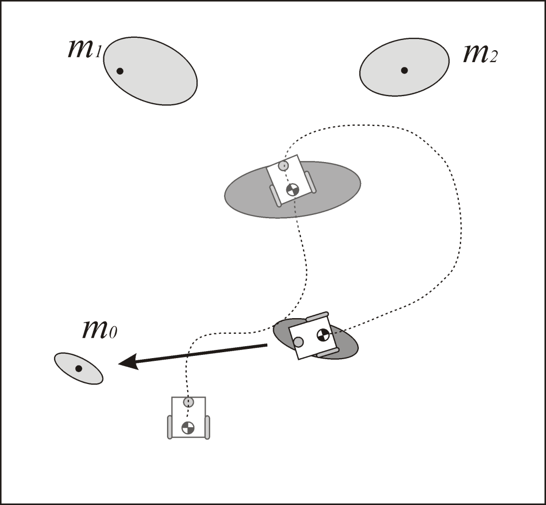
SLAM overview
In order to reduce its uncertainty, the robot must observe features whose location is relatively well known. These features can for instance be landmarks that the robot has already observed before.
In this case, the observation is called loop closure detection.
When a loop closure is detected, the robot pose uncertainty shrinks.
At the same time, the map is updated and the uncertainty of other observed features and all previous robot poses also reduce

Slide 18
The Three SLAM paradigms
Most of the SLAM algorithms are based on the following three different approaches:
Extended Kalman Filter SLAM: (called EKF SLAM)
Particle Filter SLAM: (called FAST SLAM)
Graph-Based SLAM

Slide 19
EKF SLAM: overview
The EKF SLAM proceeds exactly like the standard EKF that we have seen for robot localization, with the only difference that it uses an extended state vector y_{t} which comprises both the robot pose x_{t} and the position of all the features m_{i} in the map, that is:
If we sense 2D line-landmarks, the size of y_{t} would be 3+2n, since we need three variables to represent the robot pose and 2n variables for the n line-landmarks having vector components
As the robot moves and takes measurements, the state vector and covariance matrix are updated using the standard equations of the extended Kalman filter

Slide 20
EKF based SLAM: prediction phase
During the prediction phase, the robot pose is updated using the odometric position update formula
The position of the features, will conversely remain unchanged.
Therefore, we can write the prediction model of the EKF SLAM as

Slide 21
EKF based SLAM: Comparison with EKF localization
LOCALIZATION
The state X is ONLY the robot configuration, that is:
The prediction function is:
SLAM
The state Y is the robot configuration X plus the features m_{i}=(r_{i},φ_{i}) that is:
The prediction function is:

Slide 22
EKF based SLAM: estimation phase
The observation model is the same as the EKF localization:
The estimation proceeds in the same manner as the conventional EKF:
where

Slide 23
EKF SLAM: considerations
At start, when the robot takes the first measurements, the covariance matrix is populated by assuming that these (initial) features are uncorrelated, which implies that the off diagonal elements are set to zero.

Slide 24
EKF SLAM: considerations
However, when the robot starts moving and takes new measurements, both the robot pose and features start becoming correlated.
Accordingly, the covariance matrix becomes non-sparse.
The existence of this correlation can be explained by recalling that the uncertainty of the features in the map depends on the uncertainty associated to the robot pose. But it also depends on the uncertainty of other features that have been used to update the robot pose. This means that when a new feature is observed this contributes to correct not only the estimate of the robot pose but also that of the other features as well. The more observations are made, the more the correlations between the features will grow, the better the solution to SLAM.

Slide 25
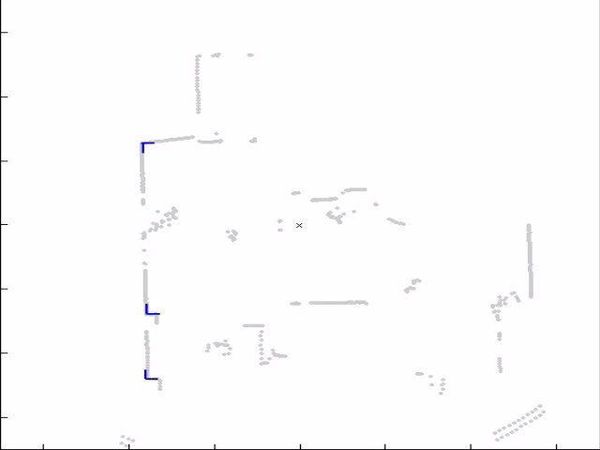
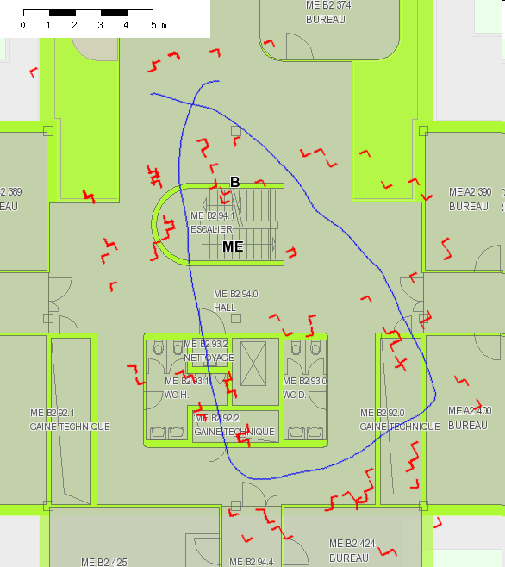
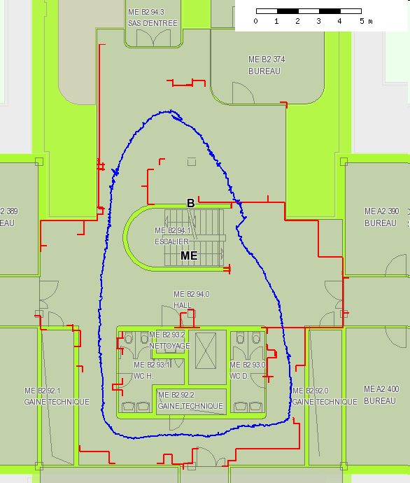
Feature Based SLAM (ETH - ASL)
corner features extracted from lines
connecting corners to structures

Slide 26
Drawbacks of EKF SLAM
Clearly, the state vector in EKF SLAM is much larger than the state vector in EKF localization where only the robot pose was being updated. This makes EKF SLAM computationally very expensive.
Notice that, because of its formulation, maps in EKF SLAM are supposed to be feature based (i.e. points, lines, planes). As new features are observed, they are added to the state vector. Thus, the noise covariance matrix grows quadratically, with size (3+2n)x(3+2n). For computational reasons, the size of the map is therefore usually limited to less than 1,000 features.

Slide 27
Particle Filter SLAM: FastSLAM
FastSLAM approach
It solves the SLAM problem using particle filters.
Each particle k :estimate of robot path and mean, and covariance of each of the n features: P^{[k]} (X_{t}^{[k]} μ^{[k];} Σ₁^{[k]} … μ^{[k]} Σ_{n}^{[k]} )
Particle filter update
In the update step a new particle distribution, given motion model and controls applied is generated.
a) For each particle:
1. Compare particle’s prediction of measurements with actual measurements
2. Particles whose predictions match the measurements are given a high weight
b) Filter resample:
Resample particles based on weight
Filter resample
Assign each particle a weight depending on how well its estimate of the state agrees with the measurements and randomly draw particles from previous distribution based on weights creating a new distribution.

Slide 28
Particle Filter SLAM 6
FastSLAM approach (continuation)
Particle set
The robot posterior is solved using a Rao Blackwellized particle filtering using landmarks. Each landmark estimation is represented by a 2x2 EKF (Extended Kalman Filter). Each particle is “independent” (due the factorization) from the others and maintains the estimate of M landmark positions.

Slide 29
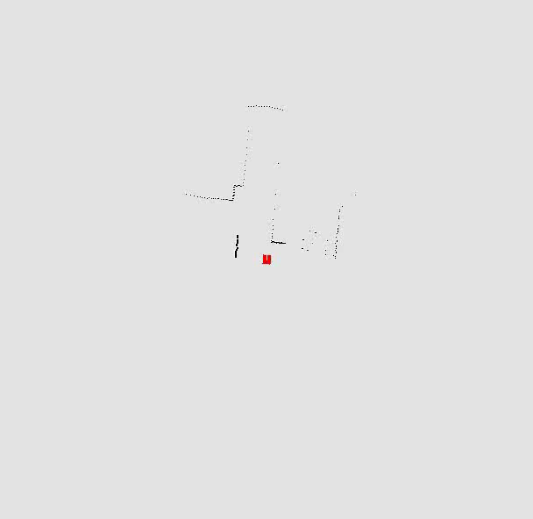
FAST SLAM example

Slide 30
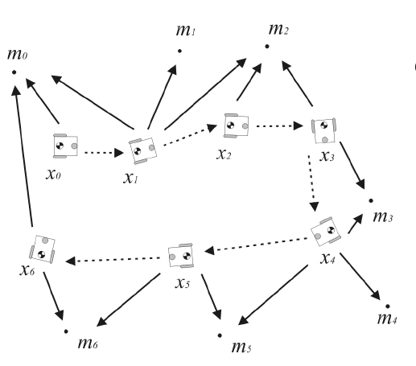
Graph-Based SLAM (1/3)
Graph-based SLAM is born from the intuition that the SLAM problem can be interpreted as a sparse graph of nodes and constraints between nodes.
The nodes of the graph are the robot locations and the features in the map.
The constraints are the relative position between consecutive robot poses , (given by the odometry input u) and the relative position between the robot locations and the features observed from those locations.

Slide 31
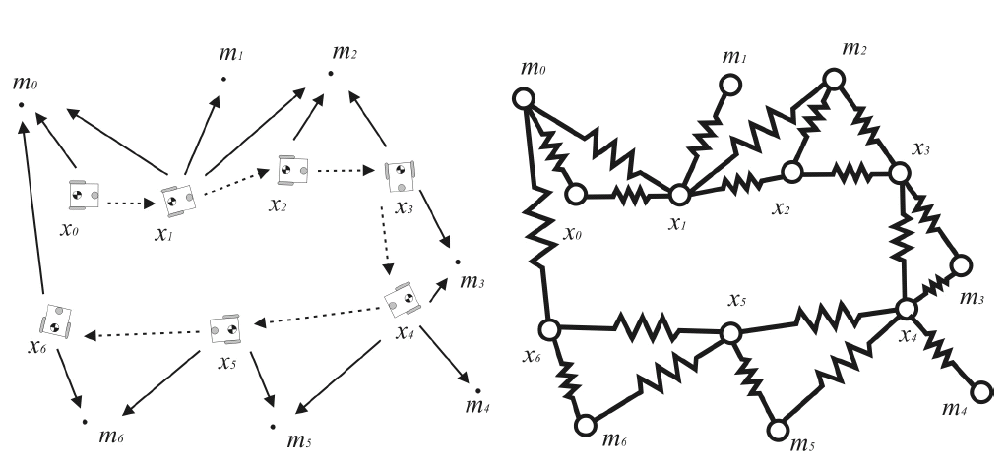
Graph-Based SLAM (2/3)
The key property to remember about graph-based SLAM is that the constraints are not to be thought as rigid constraints but as soft constraints. It is by relaxing these constraints
that we can compute the solution to the full SLAM problem, that is, the best estimate of the robot path and the environment map. By saying this in other words, graph-based SLAM represents robot locations and features as the nodes of an elastic net. The SLAM solution can then be found by computing the state of minimal energy of this net

Slide 32
Graph-Based SLAM (3/3)
There is a significant advantage of graph-based SLAM techniques over EKF SLAM. As we have seen, in EKF SLAM the amount of computation and memory requirement to update and store the covariance matrix grows quadratically in the number of features. Conversely, in graph-based SLAM the update time of the graph is constant and the required memory is linear in the number of features.
However, the final graph optimization can become computationally costly if the robot path is long.

Slide 33
Example EKF SLAM: Visual SLAM with a Single Hand-Held Camera
This example is based on the following papers:
Andrew J. Davison, Real-Time Simultaneous Localization and Mapping with a Single Camera, ICCV 2003
Nicholas Molton, Andrew J. Davison and Ian Reid, Locally Planar Patch Features for Real-Time Structure from Motion, BMVC 2004
Notes:
Pour commencer, assez simple ….

Slide 34
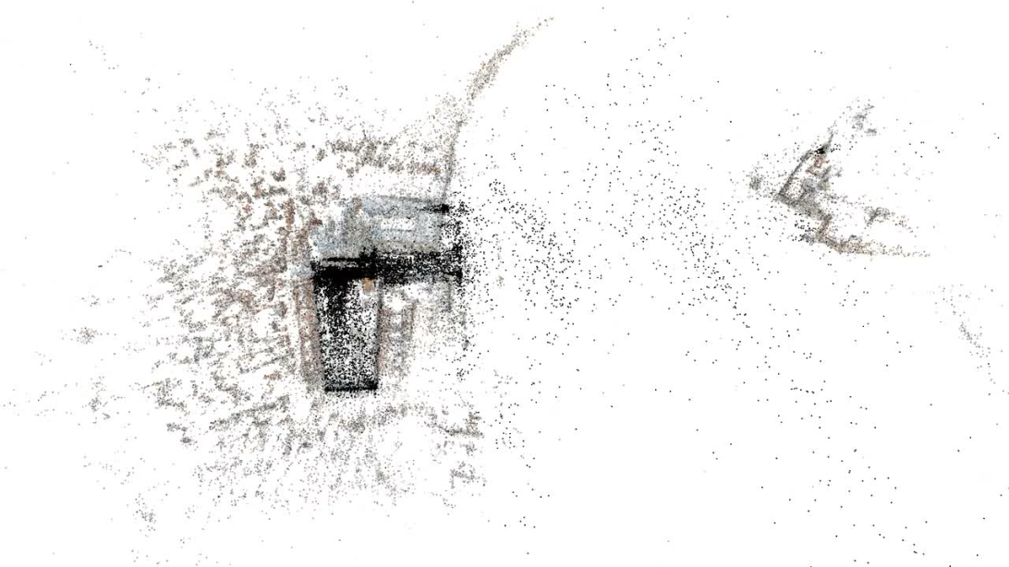
Structure From Motion (SFM)
Structure from Motion:
Take some images of the object to reconstruct
Features (points, lines, …) are extracted from all frames and matched among them
All images are processed simultaneously
Both camera motion and 3D structure can be recovered by optimally fusing the overall information, up to a scale factor (similar to Graph-based SLAM)
X_{j}
x_{1j}
x_{3j}
x_{2j}
P₁
P₃
P₂

Slide 35
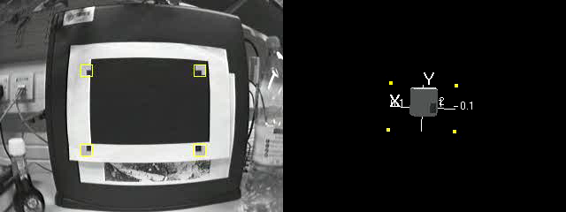
Visual SLAM
(From Davison’03)
It is Real-time!

Slide 36
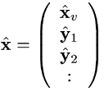
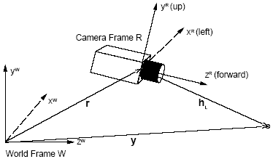
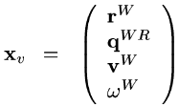
State of the System
The state vector X and the covariance matrix P are updated during camera motion using the EKF.
The state contains both the camera position (x,y,z) and the point landmarks’ 3D position:
where
where r is the camera position r = (X,Y,Z) and q is the camera orientation which is represented using quaternion (4-element vector). v and ω are the translational and rotational velocity!

Slide 37
Prediction phase
How do we compute the next camera position?
?

Slide 38
A Motion Model for Smoothly Moving Camera
Attempts to predict where the camera will be in the next time step
In the case the camera is attached to a person, the unknown intentions of the person can be statistically modeled
Most Structure from Motion approaches did not use any motion model!
Davison uses a constant velocity model!
Motion at time t-1 is motion at time t.

Slide 39
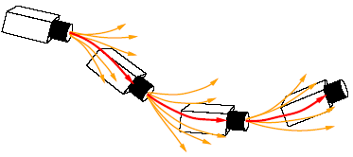
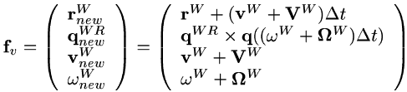
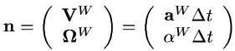
Constant Velocity Model
The unknown intentions, and so unknown accelerations, are taken into account by modeling the acceleration as a process of zero mean and Gaussian distribution:
By setting the covariance matrix of n to small or large values, we define the smoothness or rapidity of the motion we expect. In practice these values were used:

Slide 40
Estimation phase
Observation: a new feature is measured (P decreases)
Where

Slide 41
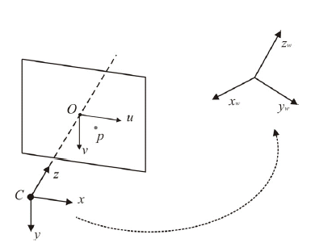
Estimation phase: predicted observation
By predicting the next camera pose, we can predict where each features is going likely to appear:
To compute the predicted observation we need to compute h(x).
h(x) is nothing but the perspective projection equation:

Slide 42
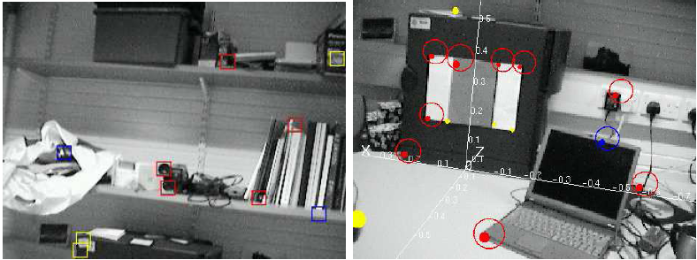
Estimation phase: predicted observation
At each frame, the features occurring at previous step are searched in the elliptic region where they are expected to be according to the motion model (Normalized Sum of Square Differences is used for matching)
Once the features are matched, the entire state of the system is updated according to EKF

Slide 43
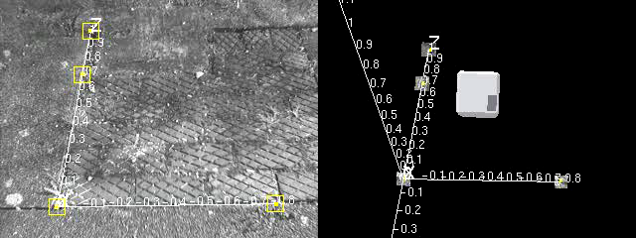

Slide 44
Improved Feature Matching
Up to now, tracked features were treated as 2D templates in image space
Long-term tracking can be improved by approximating the feature as a locally planar region on 3D world surfaces

